Slide 1
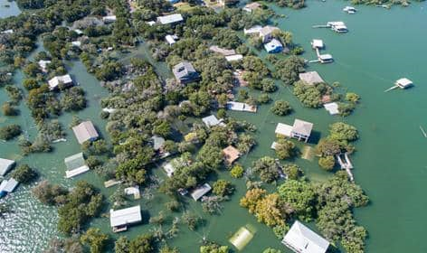
FLOOD
Disaster management
Overflow of water
By
Mr.Ramki.S
Assistant Professor & NSS Programme Officer,
St. Jospeh’s College (Arts & Science), Kovur,Chennai-128.

Slide 2
Objectives of Study
Natural Causes of Floods
Types of Floods
Safety precautions against floods
Floating floats
Dos and Don’ts During a Major Flood
A way to lives from floods

Slide 3
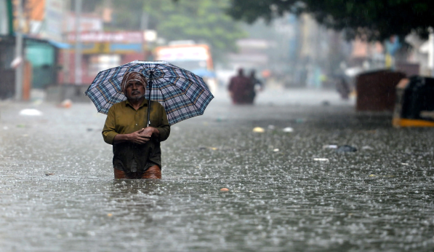
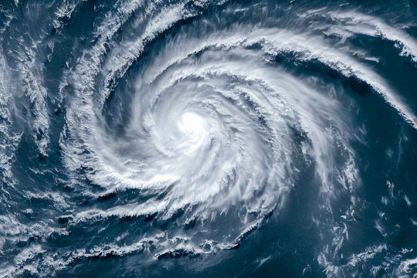

NATURAL CAUSES OF FLOODS
(i) Meteorological Factors
Heavy Rainfall
Cyclone
Global Warming

Slide 4
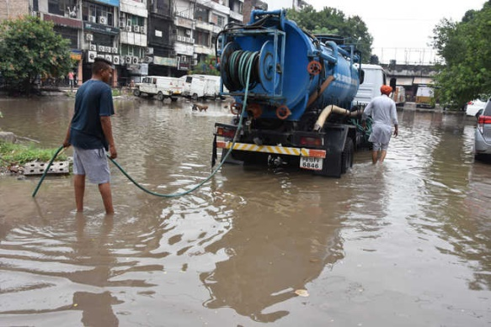
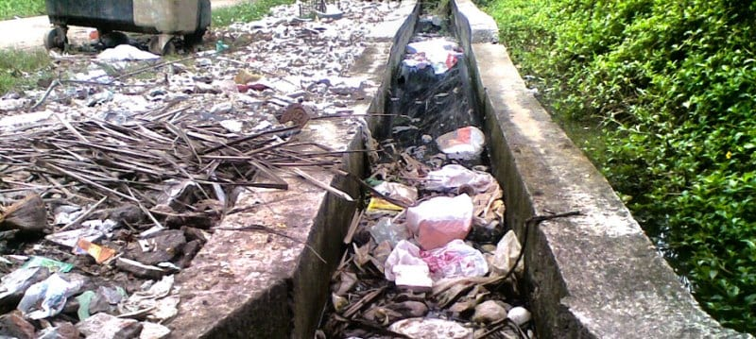
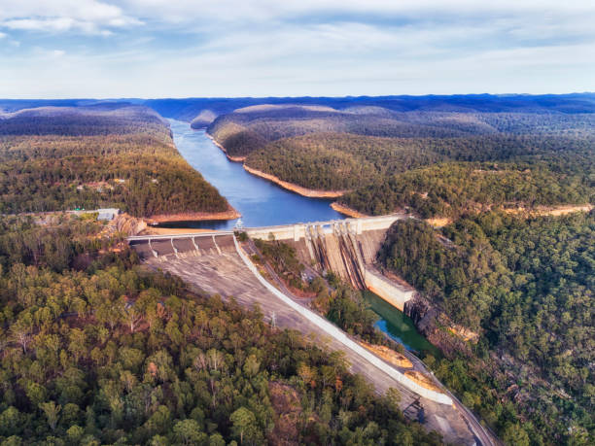
(ii) Physical Factors
Insufficient Drainage Management
Catchment Area

Slide 5
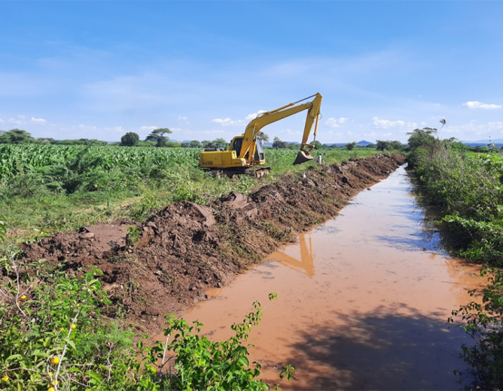

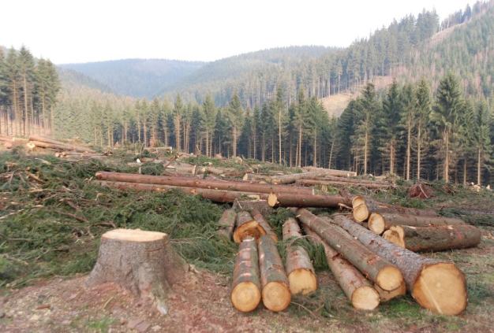
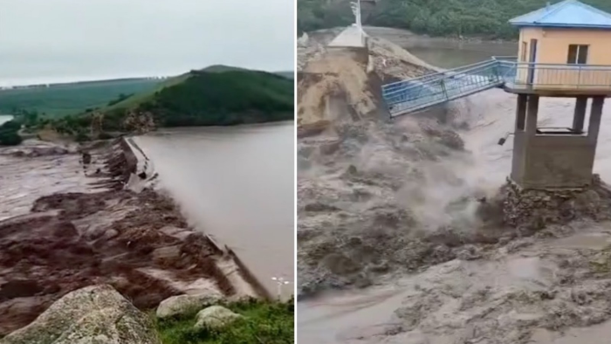
(iii) Human Factor
Siltation
Improper Agricultural Practices
Deforestation
Collapse of Dams

Slide 6
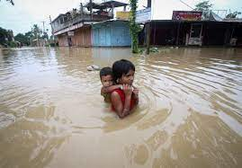
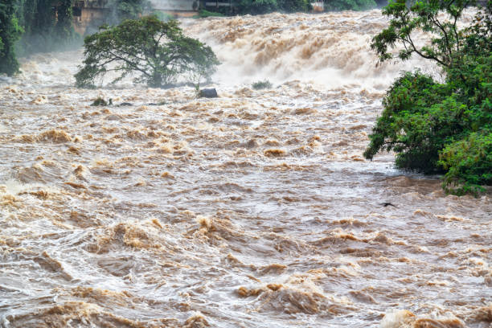
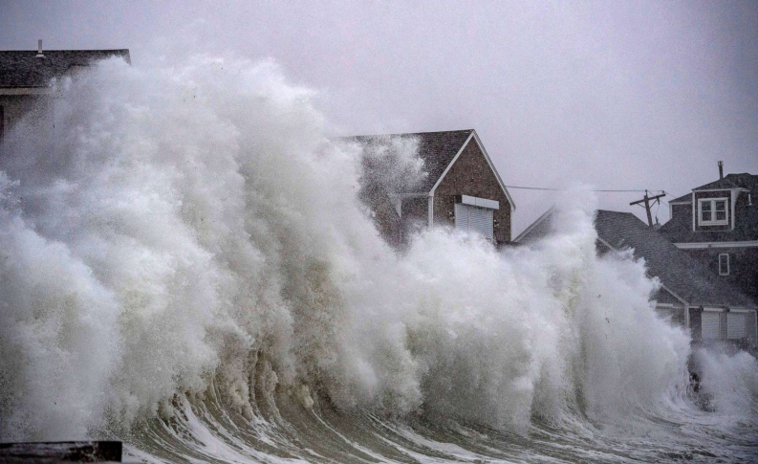
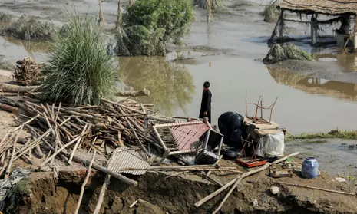
Types of Floods
Rain flood River flood
Coastal flood Ruinous flood (பேரழிவு)

Slide 7
Safety precautions against floods
Before
Ignore rumours, stay calm, don’t panic.
Keep your mobile phones charged for emergency communication; use SMS.
Listen to radio, watch TV, read newspapers for weather updates.
Keep cattle/animals untied to ensure their safety.
Prepare an emergency kit with essential items for safety and survival.
Keep your documents and valuables in water-proof bags.
Know the safe routes to nearest shelter/raised pucca house.
Evacuate immediately to safe places when directed by government officials.
Store enough ready-to-eat food and water for at least a week.
Be aware of flash flood areas such as canals, streams, drainage channels.

Slide 8
During
Don’t enter floodwaters. In case you need to, wear suitable footwear.
Stay away from sewerage lines, gutters, drains, culverts, etc.
Stay away from electric poles and fallen power lines to avoid electrocution.
Mark any open drains or manholes with visible signs (red flags or barricades).
Do not walk or drive in the flood waters. Remember, two feet of moving flood water can wash away big cars as well.
Eat freshly cooked or dry food. Keep your food covered.
Use disinfectants to keep your surroundings clean.

Slide 9
After
Do not allow children to play in or near flood waters.
Don’t use any damaged electrical goods, get them checked.
If instructed, turn off utilities at main switches and unplug appliances - do not touch electrical equipment if wet.
Watch out for broken electric poles and wires, sharp objects and debris.
Do not eat food that has been in flood waters.
Use mosquito nets to prevent malaria.
Be careful of snakes as snake bites are common during floods.
Don’t use the toilet or tap water if the water lines / sewage pipes are damaged.
Do not drink tap water until advised by the Health Department that the water is safe to drink.

Slide 10
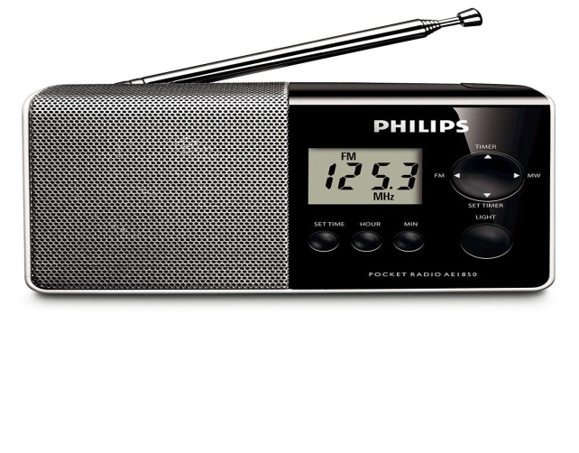
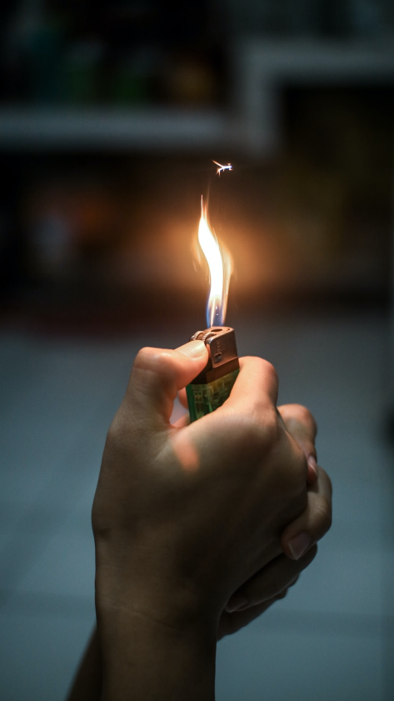
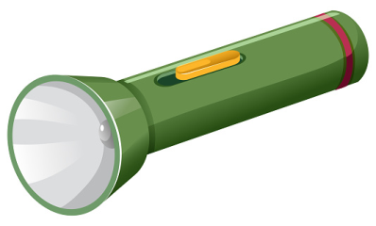
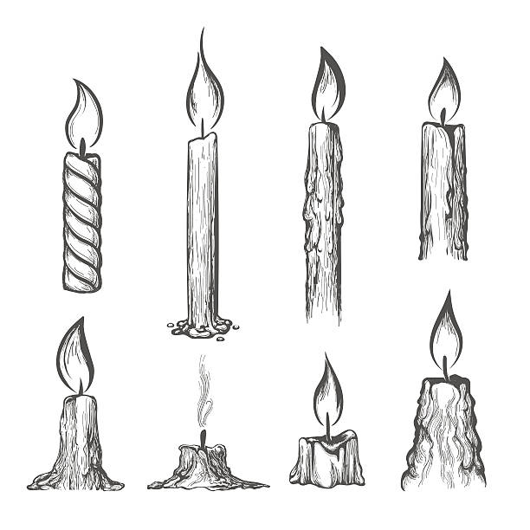
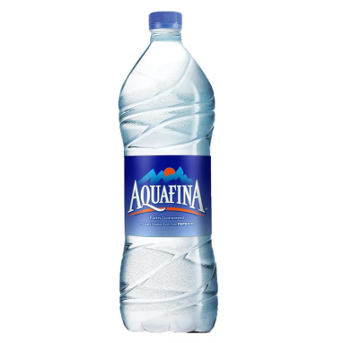

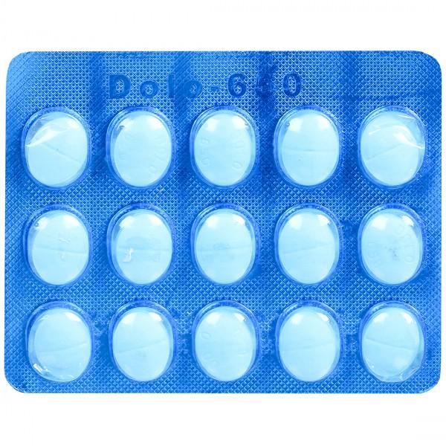
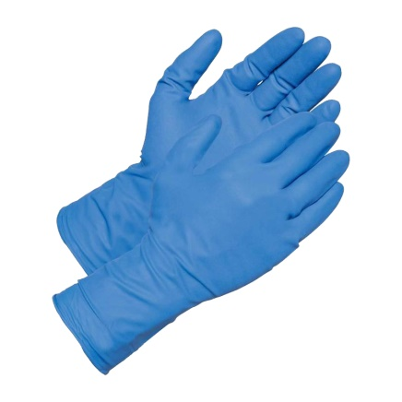
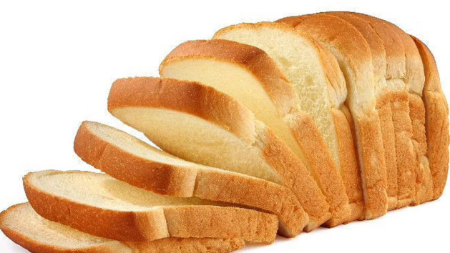
FLOOD EMERGENCY SUPPLIES NEEDED

Slide 11
Floating floats

